Slide 1

B.E COMPUTER SCIENCE AND ENGINEERING
COIMBATORE INSTITUTE OF TECHNOLOGY
(Govt Aided Autonomous Institution Affiliated to Anna University, Chennai).
PROJECT REVIEW -II
Video Voice Over using deep learning
Batch No. : 9
Team Members:
1.2005018 - Hemalakshmi S
2.2005028 - Lakshitha P
3.2005044 - Satyajit K
4.2005050 - Swarna Ambigai V
5.2005054 - Vysakh S
6.71762105207-Guru Vasuki SR
Class: IV B.E CSE Section -1
Guided by
Guide Name: Mrs.K.Priyadarsini,
M.E.,Assistant Professor
Computer Science and Engineering.

Slide 2
AGENDA
Design Modules and Description
System Design- Architecture/Flow Diagram
Tools for development
Conclusion
References

Slide 3
Design Modules and Description
Video to Frames Conversion Module - Extract individual frames from the video for further processing.
Frame Analysis Module - Analyze each frame to identify key visual elements.
Caption Generation Module - Generate captions for each frame based on the analyzed visual elements.
Encoder Module - ViT
Decoder Module- GPT2
Summarization Module - Summarization of the whole caption is performed using a summarizer.

Slide 4
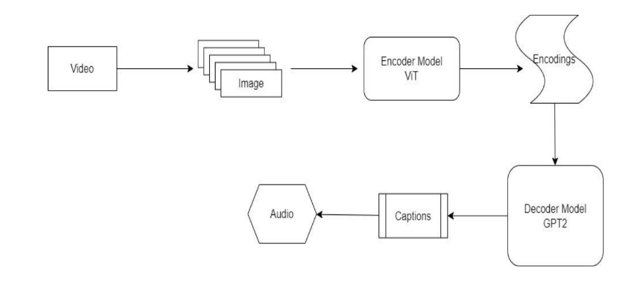
System Design- Flow Diagram

Slide 5
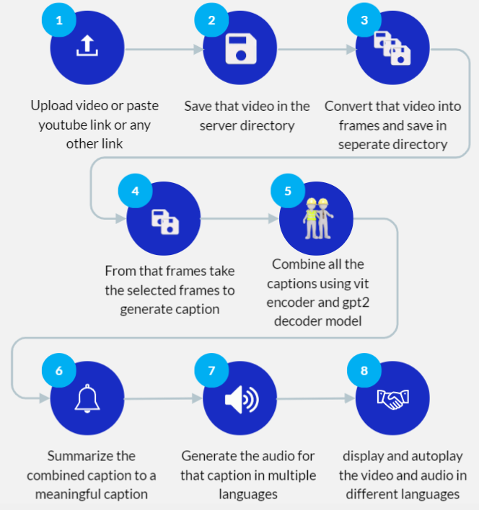
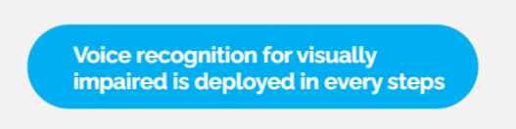
System Design- Flow Diagram

Slide 6
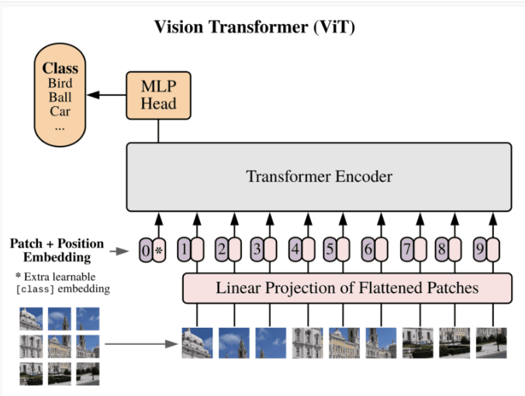

Slide 7
Tools for development
Python: Programming language for backend development and scripting.
Flask: Web framework for building the backend of the web application.
Hugging Face Transformers: Library for accessing pre-trained models for natural language processing tasks, such as image captioning.
Gensim: Library for text summarization and keyword extraction.
Google Text-to-Speech (gTTS): API for converting text to speech.

Slide 8
Tools for development
OpenCV: Library for computer vision tasks, including video processing.
Pillow (PIL): Library for working with images, including loading and processing.
HTML/CSS: Frontend markup and styling for web pages.
JavaScript: Frontend scripting for dynamic web page behavior.

Slide 9
Conclusion
Video Voice Over involves narrating key visual elements of a scene, such as actions, settings, facial expressions, and text on screen, to provide individuals with visual disabilities a comprehensive understanding of the visual context.
The availability of voice over of videos significantly enhances the overall accessibility and inclusivity of media content for the visually disabled.

Slide 10
References
[1] Pavitar Khatri, Pranay Rana, Praveen Dahiya, ‘Video Captioning using Encoder-Decoder Model’,JETIR. Multimed, vol. 10, no.3, pp. 229-241, May. 2023,ISSN-.23495162.
[2] Subhashini Venugopalan, Marcus Rohrbach, Jeff Donahue, Raymond Mooney, Trevor Darrell, Kate Saenko, ‘Sequence to Sequence- Video to Text’, IJERT. Multimed, vol. 22, no.6, pp. 229-241, Oct. 2015,arXiv: 1505.00487v3.
[3] Antoine Yang, Arsha Nagrani, Paul Hongsuck Seo, Antoine Miech., ‘Vid2Seq: Large-Scale Pretraning of a Visual Language Model for Dense Video Captioning’,IEEE. Multimed, vol. 10, no.4, pp. April. 2023,ECCV,2023
[4] Vladimir Iashin, Esa Rahtu, ‘Multi-Model Dense Video Captioning’, IEEE. Multimed, vol. 10, no.2, pp., Oct. 2020,In CVPR,2020.

